Slide 1


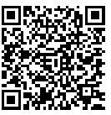
https://bit.ly/3bGN5PW
Humanitarian IT conference
Small Croatian towns of Petrinja, Sisak and Glina have been seriously hit with a massive earthquake on 29 December 2020.
Microsoft Most Valuable Professionals from all around Europe are organizing humanitarian IT conference to help the victims which lost their loved ones and their homes.
Join us in one of the kind conference with top MVP speakers in 4 tracks on Saturday, 16th January 2021 from 9AM till 5PM.
THANK YOU!

